Slide 1

Introduction to Data Analytics
GOA COLLEGE OF ENGINEERING
Affiliated to Goa University
INFORMATION TECHNOLOGY DEPARTMENT
Vision
Impart high quality knowledge and skills to students in the field of Information Technology ,motivate research, encourage industry consultancy projects and nurture human values and life skills.
Prepared By,
Ms. Diana Miranda
Assistant Professor
Dept. of Information Technology
Goa College of Engineering

Slide 2
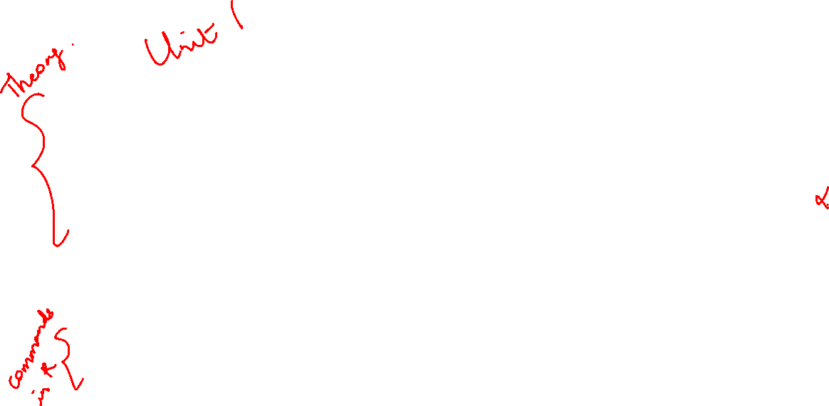
Introduction to Big Data Analytics: Big Data Overview, State of the Practice in Analytics, Key Roles for the New Big Data Ecosystem, Examples of Big Data Analytics
Data Analytics Lifecycle, Data Analytics Lifecycle Overview, Phase 1: Discovery, Phase 2: Data Preparation, Phase 3: Model Planning, Phase 4: Model Building, Phase 5: Communicate Results, Phase 6: Operationalize, Case Study: Global Innovation Network and Analysis (GINA)
Review of Basic Data Analytic Methods Using R, Introduction to R, Exploratory Data Analysis, Statistical Methods for Evaluation

Slide 3
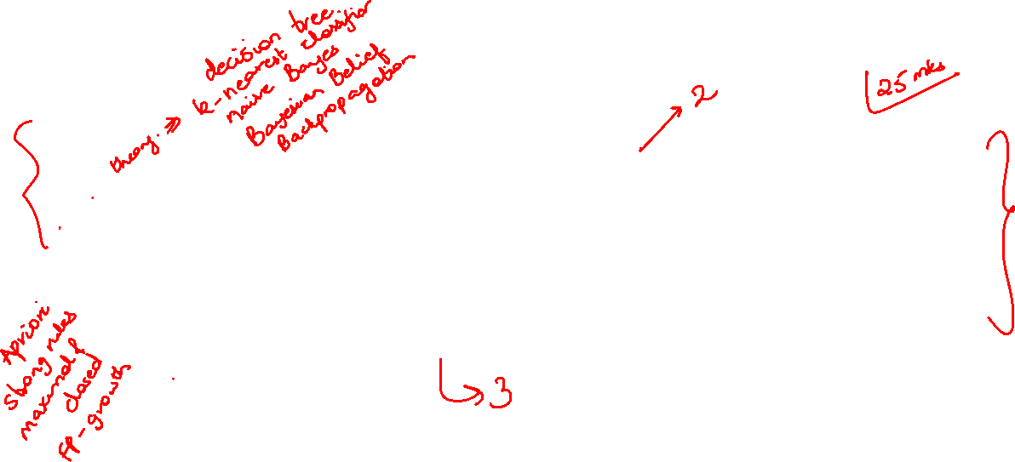
Introduction to Classification & Prediction: Classification by Decision tree induction, Bayesian Classification, k-Nearest Neighbor Classifier, Classification by Back propagation, Introduction to Prediction Concept
Data Mining Association Rules. Association Rule Mining. Mining Single Dimensional Boolean Association Rules from Transactional Databases.

Slide 4
Topics to be Covered
Big Data Overview
State of the Practice in Analytics
Key Roles for the New Big Data Ecosystem
Examples of Big Data Analytics

Slide 5
Big Data Overview

Slide 6
Big Data Overview
Several industries have led the way in developing their ability to gather and exploit data:
Credit card companies
Mobile phone
Social media companies such as LinkedIn and Facebook

Slide 7
Attributes of Big Data
Volume
Huge volume of data
Variety
Complexity of data types and structures
Velocity
Speed of new data creation and growth

Slide 8
Definition
Big Data is data whose scale, distribution, diversity, and/or timeliness require the use of new technical architectures and analytics to enable insights that unlock new sources of business value.
McKinsey & Co.; Big Data: The Next Frontier for Innovation, Competition, and Productivity

Slide 9
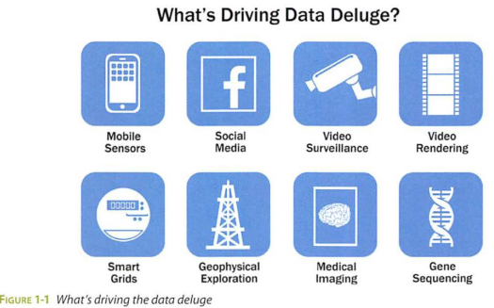

Slide 10
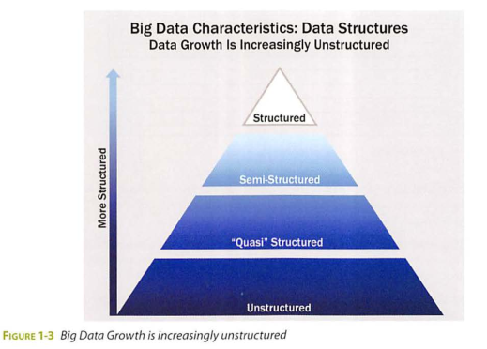
Data Structures

Slide 11
Structured data: Data containing a defined data type, format, and structure (that is, transaction data, online analytical processing [OLAP] data cubes, traditional RDBMS, CSV files, and even simple spreadsheets).
Semi-structured data: Textual data files with a discernible pattern that enables parsing (such as Extensible Markup Language [XML] data files that are self-describing and defined by an XML schema).
Quasi-structured data: Textual data with erratic data formats that can be formatted with effort, tools, and time (for instance, web clickstream data that may contain inconsistencies in data values and formats).
Unstructured data: Data that has no inherent structure, which may include text documents, PDFs, images, and video.

Slide 12
Analyst Perspective on Data Repositories
Data Repository | Characteristics
Spreadsheets and data marts ("spreadmarts") | Spreadsheets and low-volume databases for recordkeeping Analyst depends on data extracts. Proliferation can result in "many versions of the truth."
Data Warehouses | Centralized data containers in a purpose-built space Supports Bl and reporting, but restricts robust analyses Analyst dependent on IT and DBAs for data access and schema changes Analysts must spend significant time to get aggregated and disaggregated data extracts from multiple sources.
Analytic Sandbox (workspaces) | Data assets gathered from multiple sources and technologies for analysis Enables flexible, high-performance analysis in a nonproduction environment; can leverage in-database processing Reduces costs and risks associated with data replication into "shadow" file systems "Analyst owned" rather than "DBA owned"

Slide 13
State of the Practice in Analytics

Slide 14
Business Drivers for Advanced Analytics
Business Driver | Examples
Optimize business operations | Sales, pricing, profitability, efficiency
Identify business risk | Customer churn, fraud, default
Predict new business opportunities | Upsell, cross-sell, best new customer prospects
Comply with laws or regulatory requirements | Anti-Money Laundering, Fair Lending, Basel II-III, Sarbanes Oxley(SOX)

Slide 15
BI Versus Data Science
BI
Provides reports, dashboards, and queries on business questions for the current period or in the past.
Make it easy to answer questions related to quarter-to-date revenue, progress toward quarterly targets, and understand how much of a given product was sold in a prior quarter or year.
These questions tend to be closed-ended and explain current or past behavior, typically by aggregating historical data and grouping it in some way.
Provides hindsight and some insight and generally answers questions related to "when" and "where" events occurred.
Require highly structured data organized in rows and columns for accurate reporting
Data Science
Uses disaggregated data in amore forward-looking, exploratory way, focusing on analyzing the present and enabling informed decisions about the future.
Rather than aggregating historical data to look at how many of a given product sold in the previous quarter, a team may employ Data Science techniques to forecast future product sales and revenue more accurately than extending a simple trend line.
More exploratory in nature and may use scenario optimization to deal with more open-ended questions.
This approach provides insight into current activity and foresight into future events, while generally focusing on questions related to "how" and "why" events occur.
Uses many types of data sources, including large or unconventional datasets.

Slide 16
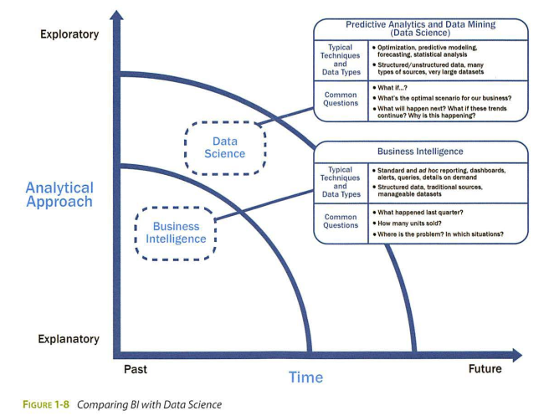

Slide 17
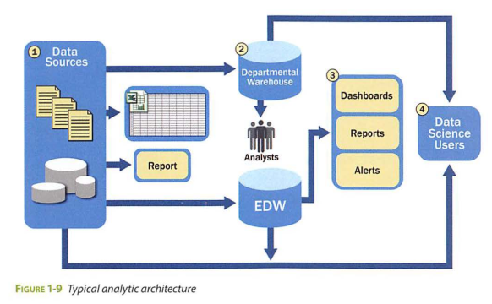
Current Analytical Architecture

Slide 18
For data sources to be loaded into the data warehouse, data needs to be well understood, structured, and normalized with the appropriate data type definitions. Although this kind of centralization enables security, backup, and failover of highly critical data, it also means that data typically must go through significant preprocessing and checkpoints before it can enter this sort of controlled environment, which does not lend itself to data exploration and iterative analytics.
As a result of this level of control on the EDW, additional local systems may emerge in the form of departmental warehouses and local data marts that business users create to accommodate their need for flexible analysis. These local data marts may not have the same constraints for security and structure as the main EDW and allow users to do some level of more in-depth analysis. However, these one-off systems reside in isolation, often are not synchronized or integrated with other data stores, and may not be backed up.
Once in the data warehouse, data is read by additional applications across the enterprise for Bl and reporting purposes. These are high-priority operational processes getting critical data feeds from the data warehouses and repositories.
At the end of this workflow, analysts get data provisioned for their downstream analytics. Because users generally are not allowed to run custom or intensive analytics on production databases, analysts create data extracts from the EDW to analyze data offline in R or other local analytical tools. Many times these tools are limited to in-memory analytics on desktops analyzing samples of data, rather than the entire population of a dataset. Because these analyses are based on data extracts, they reside in a separate location, and the results of the analysis-and any insights on the quality of the data or anomalies-rarely are fed back into the main data repository.

Slide 19
Traditional data architectures have several additional implications for data scientists.
High-value data is hard to reach and leverage, and predictive analytics and data mining activities are last in line for data. Because the EDWs are designed for central data management and reporting, those wanting data for analysis are generally prioritized after operational processes.
Data moves in batches from EDW to local analytical tools. This workflow means that data scientists are limited to performing in-memory analytics (such as with R, SAS, SPSS, or Excel), which will restrict the size of the datasets they can use. As such, analysis may be subject to constraints of sampling, which can skew model accuracy.
Data Science projects will remain isolated and ad hoc, rather than centrally managed. The implication of this isolation is that the organization can never harness the power of advanced analytics in a scalable way, and Data Science projects will exist as nonstandard initiatives, which are frequently not aligned with corporate business goals or strategy.

Slide 20
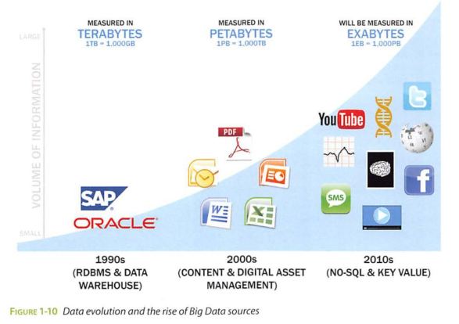
Drivers of Big Data

Slide 21
Data now comes from multiple sources, such as these:
Medical information, such as genomic sequencing and diagnostic imaging
Photos and video footage uploaded to the World Wide Web
Video surveillance, such as the thousands of video cameras spread across a city
Mobile devices, which provide geospatial location data of the users, as well as metadata about text messages, phone calls, and application usage on smart phones
Smart devices, which provide sensor-based collection of information from smart electric grids, smart buildings, and many other public and industry infrastructures
Nontraditional IT devices, including the use of radio-frequency identification (RFID) readers, GPS navigation systems, and seismic processing

Slide 22
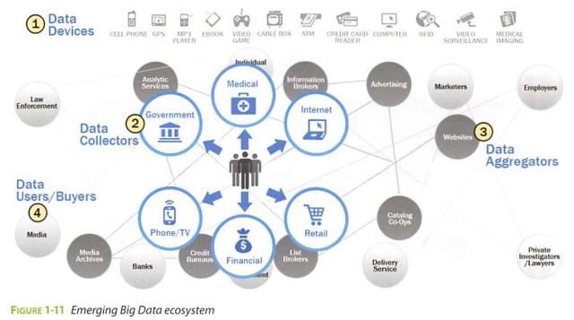
Emerging Big Data Ecosystem and a New Approach to Analytics
As the new ecosystem takes shape, there are four main groups of players within this interconnected web:
Data devices and the "Sensor net" gather data from multiple locations and continuously generate new data about this data.
Data collectors include sample entities that collect data from the device and users
Data aggregators make sense of the data collected from the various entities from the "Sensor Net" or the "Internet of Things." These organizations compile data from the devices and usage patterns collected by the data collectors. ln turn, they can choose to transform and package the data as products to sell to list brokers.
Data users and buyers directly benefit from the data collected and aggregated by others within the data value chain.

Slide 23
Key Roles for the New Big Data Ecosystem

Slide 24
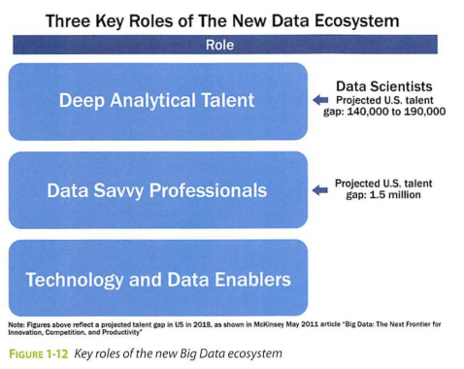
Deep Analytical Talent
Technically savvy, with strong analytical skills.
Members possess a combination of skills to handle raw, unstructured data and to apply complex analytical techniques at massive scales.
This group has advanced training in quantitative disciplines, such as mathematics, statistics, and machine learning.
To do their jobs, members need access to a robust analytic sandbox or workspace where they can perform large-scale analytical data experiments.
Examples of current professions fitting into this group include statisticians, economists, mathematicians, and the new role of the Data Scientist.
Data Savvy Professional
Have less technical depth but has a basic knowledge of statistics or machine learning and can define key questions that can be answered using advanced analytics.
These people tend to have a base knowledge of working with data, or an appreciation for some of the work being performed by data scientists and others with deep analytical talent.
Examples of data savvy professionals include financial analysts, market research analysts, life scientists, operations managers, and business and functional managers.
Technology and Data Enablers
People providing technical expertise to support analytical projects, such as provisioning and administrating analytical sandboxes, and managing large-scale data architectures that enable widespread analytics within companies and other organizations.
This role requires skills related to computer engineering, programming, and database administration.

Slide 25
There are three recurring sets of activities that data scientists perform:
Reframe business challenges as analytics challenges.
Specifically, this is a skill to diagnose business problems, consider the core of a given problem, and determine which kinds of candidate analytical methods can be applied to solve it.
Design, implement, and deploy statistical models and data mining techniques on Big Data
This set of activities is mainly what people think about when they consider the role of the Data Scientist namely, applying complex or advanced analytical methods to a variety of business problems using data.
Develop insights that lead to actionable recommendations.
It is critical to note that applying advanced methods to data problems does not necessarily drive new business value. Instead, it is important to learn how to draw insights out of the data and communicate them effectively.

Slide 26
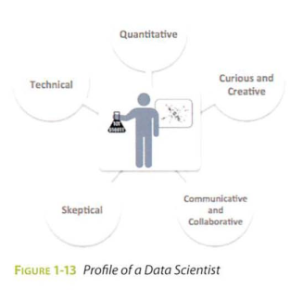
Data scientists are generally thought of as having five main sets of skills and behavioral characteristics:
Quantitative skill: such as mathematics or statistics
Technical aptitude: namely, software engineering, machine learning, and programming skills
Skeptical mind-set and critical thinking: It is important that data scientists can examine their work critically rather than in a one-sided way.
Curious and creative: Data scientists are passionate about data and finding creative ways to solve problems and portray information.
Communicative and collaborative: Data scientists must be able to articulate the business value in a clear way and collaboratively work with other groups, including project sponsors and key stakeholders

Slide 27
Examples of Big Data Analytics

Slide 28
Target's statisticians determined that the retailer made a great deal of money from three main life-event situations.
Marriage, when people tend to buy many new products
Divorce, when people buy new products and change their spending habits
Pregnancy, when people have many new things to buy and have an urgency to buy them
Target determined that the most lucrative of these life-events is the third situation: pregnancy.
Using data collected from shoppers, Target was able to identify this fact and predict which of its shoppers were pregnant.
In one case, Target knew a female shopper was pregnant even before her family knew.
This kind of knowledge allowed Target to offer specific coupons and incentives to their pregnant shoppers.
In fact, Target could not only determine if a shopper was pregnant, but in which month of pregnancy a shopper may be.

Slide 29
Hadoop
Apache Hadoop is an open source framework that allows companies to process vast amounts of information in a highly parallelized way.
Hadoop represents a specific implementation of the MapReduce paradigm and was designed by Doug Cutting and Mike Cafarella in 2005 to use data with varying structures.
It is an ideal technical framework for many Big Data projects, which rely on large or unwieldy datasets with unconventional data structures.
One of the main benefits of Hadoop is that it employs a distributed file system, meaning it can use a distributed cluster of servers and commodity hardware to process large amounts of data.
Some of the most common examples of Hadoop implementations are in the social media space, where Hadoop can manage transactions, give textual updates, and develop social graphs among millions of users.
Twitter and Facebook generate massive amounts of unstructured data and use Hadoop and its ecosystem of tools to manage this high volume.

